Slide 1
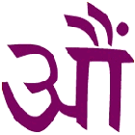
Hinduism

Slide 2
History of Hinduism
About 3000 BC…. Aryans from Central Europe migrated to Indus valley and intermingled with the natives
Indus valley civilization…. The human settlement around river Indus… so the name Hindus
The Original name of Hinduism is Sanatana Dharma which means Eternal or Universal Righteousness

Slide 3
Basic Principles….
How did Hinduism come into existence?
It was NOT started by just one sage or a prophet…but evolved over thousands of years through the preachings of many saints and holy men.

Slide 4
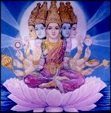
Basic Principles….
According to Hinduism…. God is one but different people realize God in different forms. The Universal Reality is the same, but different people can call it by different names"
Monotheism or Polytheism?

Slide 5
Main Scriptures…
The Vedas: Vedic theism is based on moral values. The Vedas comprise of mantras ... the hymns which emphasize on Truth and Eternal Order
It advocates a lot of rituals and sacrificial duties

Slide 6
Main Scriptures…
The Upanishads
108 in number - Came out later in time as a strong reactionary against ritual and sacrificial duties suggested in Vedas.

Slide 7
The Epics
Ramayana and Mahabharata: Preach moral and social values through stories and parables.
The Shastras
Principles for conduct of life

Slide 8
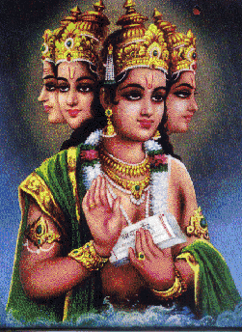
Various Gods
Brahma
The Creator

Slide 9
Vishnu
The Preserver

Slide 10
Shiva
The Destroyer

Slide 11
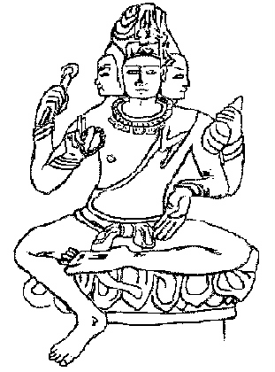
Brahman
Universal spirit

Slide 12
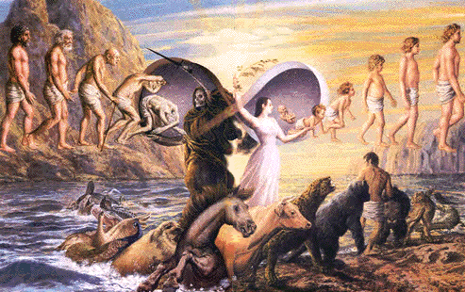
Reincarnation
A soul undergoes rebirth until salvation

Slide 13
Caste System
Ranking system based on birth

Slide 14
Karma
Your actions determine your journey in life

Slide 15
Dharma
an individual’s religious and moral duties

Slide 16
Dharma
an individual’s religious and moral duties

Slide 17
What is your Dharma?

Slide 18
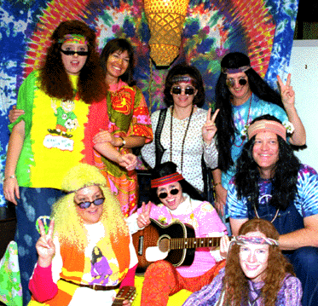
Ahimsa
(Non-violence) & Vegetarianism, Meditation & Yoga

Slide 19
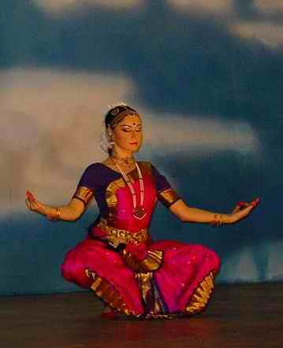
Moksha: Union with Brahman

Slide 20
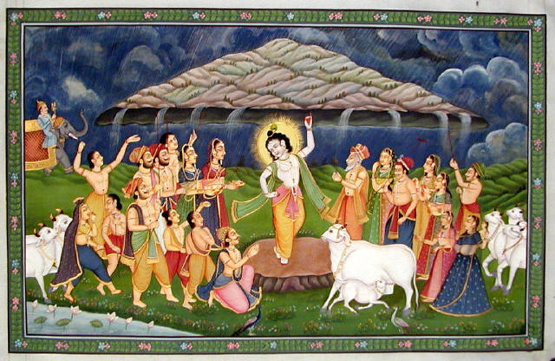
Cows – sacred animals

Slide 21
Festivals…
Ganesh Chaturthi: Celebrates the birth of the elephant faced god Ganesh.

Slide 22
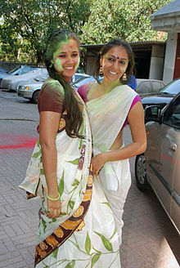
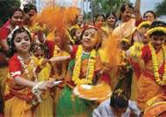
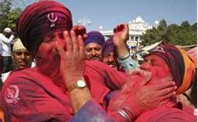
Festivals…
Holi : Festival of colors… celebrating the arrival of Spring.

