Slide 1
Enduring Issue Check-In
Impact of Interconnectedness:
The state of having connections or relationships with other people.
Trade
Trade between regions often leads to Cultural Diffusion.

Slide 2
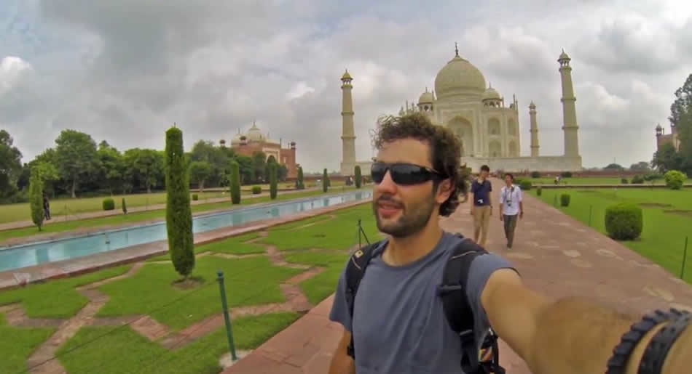
Modern World Explorer?
https://www.youtube.com/watch?v=VTlXttQL_Yk

Slide 3
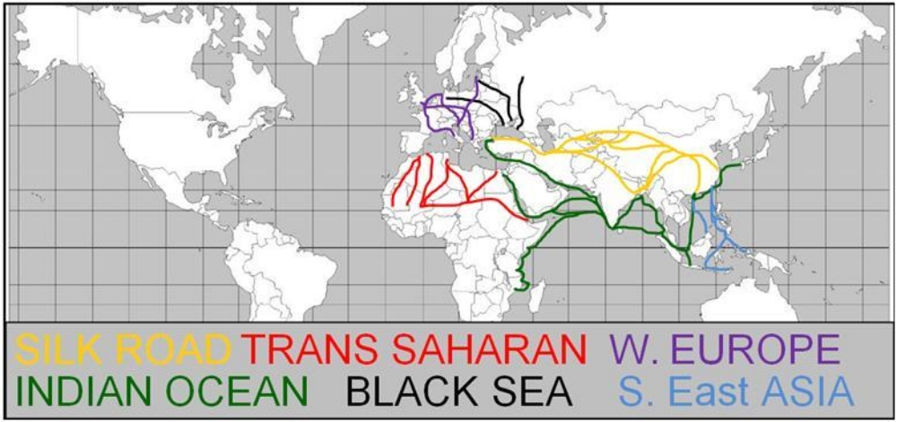
Important Trade Routes

Slide 4
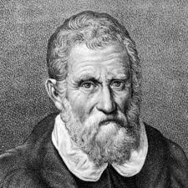
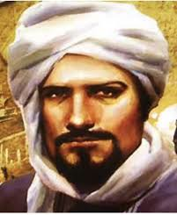
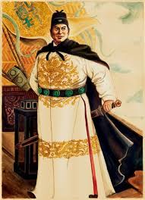
Important World Explorers
Marco Polo, Ibn Battuta, and Zheng He

Slide 5
One More…Mansa Musa

Slide 6
Important Medieval Trade Cities
Venice
Constantinople/Istanbul
Timbuktu
Cairo
Mecca
Mogadishu
Malindi
Mombasa
Kilwa
Sofala
Baghdad
Damascus
Mumbai
Goa
Malacca
Gangzhou

