Slide 1
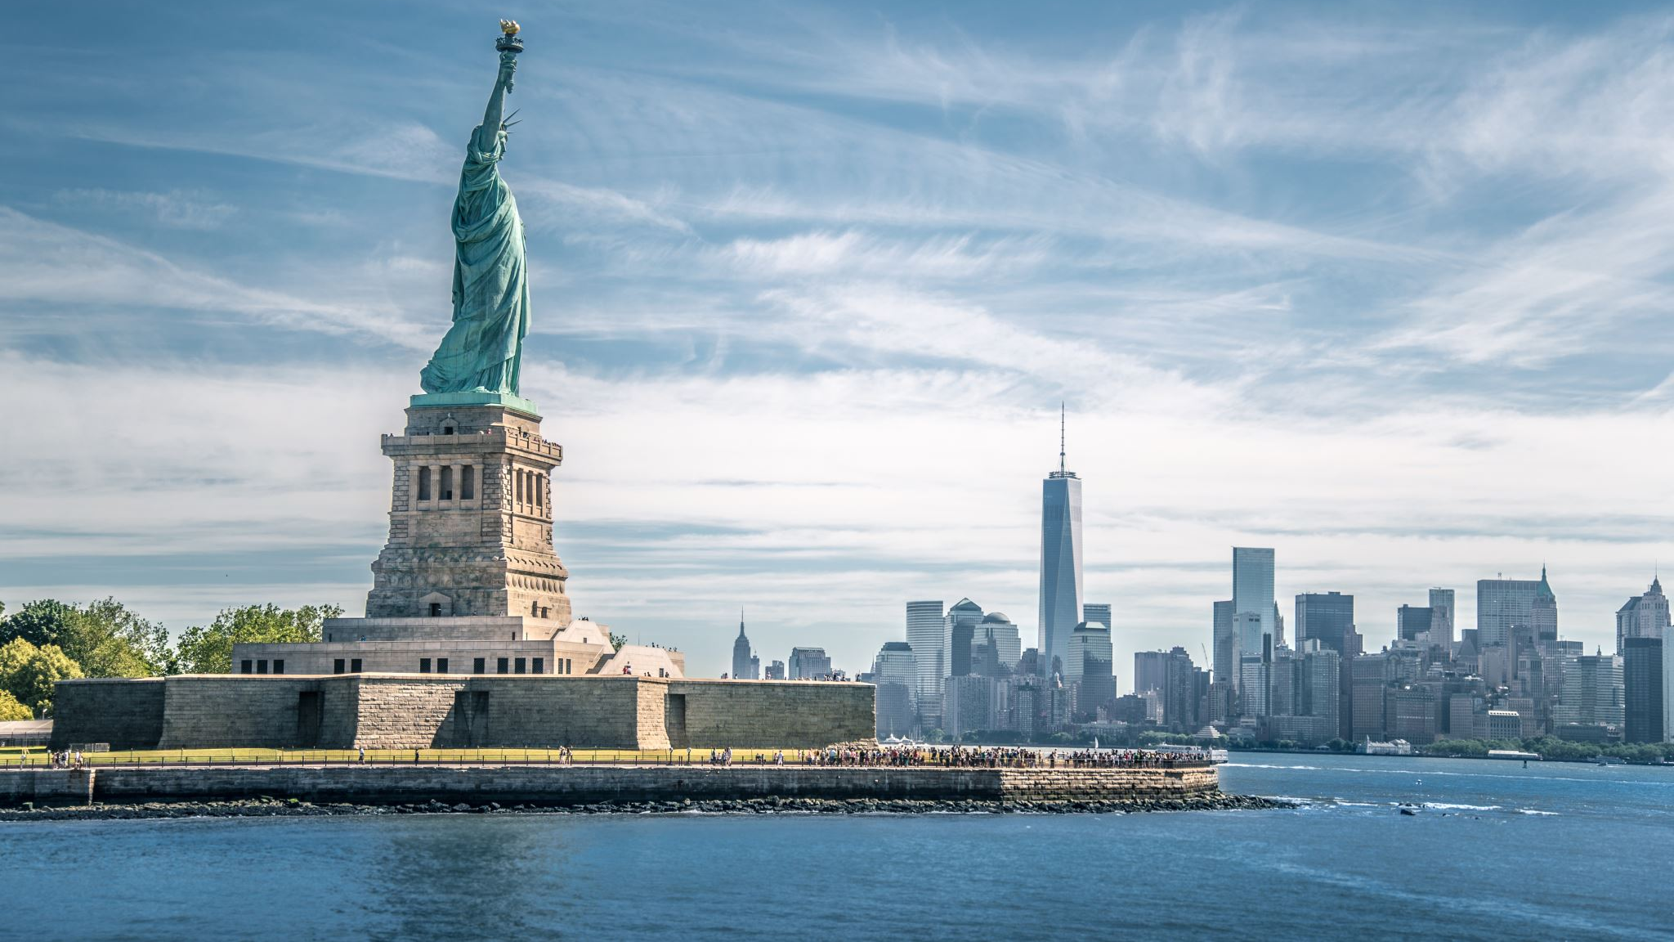
Local Societal Problem
Participation in Government 12

Slide 2
Google Slides
Please create a new Google Slides Deck- Share with lkunze@pvcsd.org and kgibson@pvcsd.org
Also share within your group.
You will get grades for completing assignments by certain due dates
Larger grade by the end of the quarter for presenting information to class
First 3 slides are due by end of class 10/21

Slide 3
Slide 1 TOPIC SLIDE
Briefly state your societal problem and which area in Putnam County it applies to (i.e. Town of Putnam Valley, Putnam County, Putnam Valley Central School District).
Images!
Your Name(s)

Slide 4
Slide 2 DESCRIPTION
Restate your societal problem and which area in Putnam County it applies to (i.e. Town of Putnam Valley, Putnam County, Putnam Valley Central School District).
Briefly describe this geographical area. Give some background information about this area. (Statistics are great!)
Clearly describe the effects of the problem on this area. Discuss the most important (only one) of the six societal goals the problem threatens.
Provide full citations of your sources on a Works Cited page. MLA

Slide 5
Slide 3 EVIDENCE
Provide 2-3 pieces of evidence
At least one of the three pieces of evidence must be based on a quote from a player, stakeholder or expert you have contacted or a source suggested or published by that player. Provide a brief video of this players quote!
At least one piece of evidence should be based on Statistical Data!
Provide full citations of your sources on a Works Cited page. MLA

Slide 6
Slide 4 EVIDENCE 2 - Polling
Add some polling data!
Mrs DeMaine will show us the easiest way to get more evidence for your local problem!
What do local people think about this problem?
2-3 questions-
Try to include a question asking for their demographics. (Age, Gender)
Try to ask about the problem- and possibly how strongly they feel this is a problem!
Poll people out of class and include a poll for our class to take!

Slide 7
Unique Opportunity
Enhance your presentation!!!
Incorporate something from the visit to the Putnam Valley Town Hall!

Slide 8
Slide 5 Describing the Current Policy
A. Describe one current policy now in effect in Putnam County to remedy the problem you described on previous slides. The policy can originate at a local, state or national level but must be operating in the county.
B. Identify the legislative body that is the original source of this policy. State the geographic location over which the legislature has the authority to act.
C. Identify the administrative unit primarily responsible for implementing the policy. State the geographic level over which the agency has the authority to act.
***D. Describe how a court at any level (local, state, federal) could be involved in the application of the policy.

Slide 9
Slide 6 Examining the News Media's Discussion of Societal Problems
-Select a recent article from the news that discusses a societal problem. Describe how well the author presents the "societal problem," "evidence of the problem," and "causes of the problem.”
-Create another QR Code to have students look at it while you present it.

Slide 10
Slide 7 Describing the Role of Business and Non‑Profit Organizations
Identify a business corporation or Non-Profit Organization that takes action to reduce the societal problem you are studying at any level, not necessarily in Putnam County.
Provide one piece of evidence either from the company itself or another source, that the corporation actually takes that action.

Slide 11
Slide 8 Developing Public Policy Alternatives
Describe 3 public policy alternatives to the existing policy to deal with your societal problem.
No credit will be given if you propose an existing policy although you could propose a change in that policy.
For each policy, state the government agency creating or implementing the policy. In order to receive credit for this exercise, all three alternatives must be able to be implemented by one or more agencies that have authority in the geographic location your policy is targeted.

Slide 12
Bonus
Take a class poll (Another QR Code) asking the class to choose which Public Policy alternative they like the best. Include ”none of the above.”
Get another interview/quote from one of your player commenting on one or all of your Public Policy alternatives
Bring in treats!!

