Slide 1
HistoryvHollywood Productions
Movie Pitch Presentation by Mr. L Kunze

Slide 2
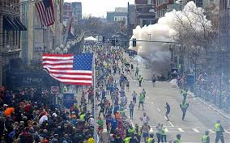
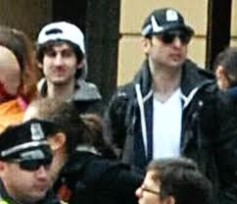
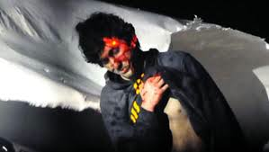
Patriots’ Day
Is a Docudrama that will show the events of the 2013 Boston Marathon Bombing and manhunt for the two suspects in the days following- in real time!

Slide 3
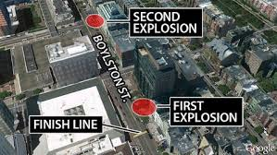
Historical Information
Patriots’ Day: (the Holiday in New England) 5 things you should know! USA Today
Boston Marathon: Every third Monday in April since 1897.
Timeline of Events of the Day:
Boston Marathon Bombing: April 15th 2013
ABC News
Primary Source
Raw Footage:
https://www.youtube.com/watch?v=GgUUm8mcqzs

Slide 4
Historical Accuracy- Docudrama
The filmmakers will attempt to be as accurate as possible. We will use a variety of news sources, primary sources, and even interview police, government officials, and survivors from the event to create a drama with the attention to detail of a documentary.
History Grade: A
History teachers could use this film as a historical source- however there will be a great deal of graphic violence.
We are expecting the film to be given an R Rating by the MPAA.
*A percentage of movie profit will go to a memorial fund for those who perished on that day.

Slide 5
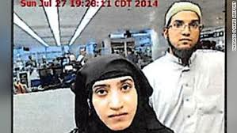
Why?
We believe this script has potential to have very high demand and be very well received.
American audiences love patriotic films!
American audiences love action!
Very topical- Terrorism a Global threat!
Fact: The Boston Marathon Bombing was the most googled event of 2013…and Dzhokar Tsarnev was the 3rd most googled person of 2013.
www.google.com/trends

Slide 6
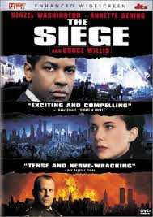
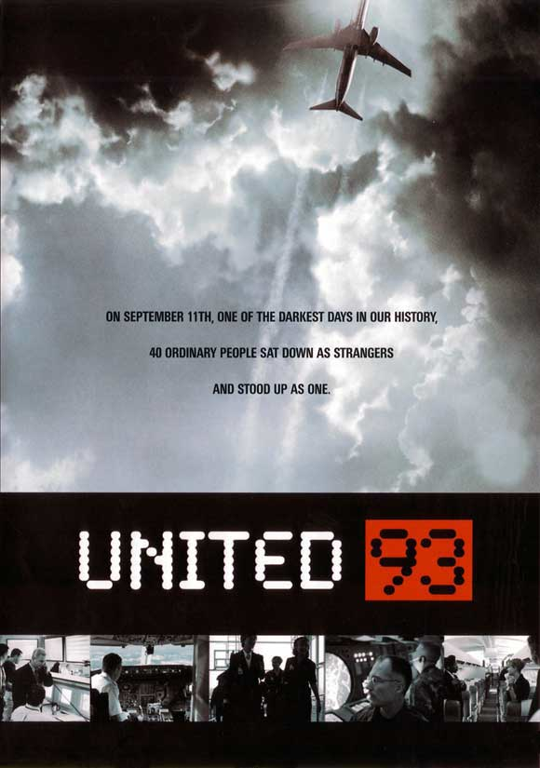
Similar Films
A similar film is United 93.
“Patriots Day” will incorporate the same style visually, as well as the research and attention to detail.
The Seige – 1998 Bruce Willis, Denzel Washington film about Terrorism in NYC and a General declaring Martial Law in Manhattan.
Both of these films were Box office hits (See here- Boxoffice mojo) + we believe Patriots Day will do even better!

